Slide 1

FERRARI (‘RACE’) VALUATION
Can the Ferrari brand successfully absorb an industry-wide structural transition toward zero-emission?
March 2026
A. Ananyan

Slide 2
Exceptional Company, Overvalued Stock
Structural EV transition threatens long-term pricing power
1
Core tension: Luxury scarcity vs EV standardization
2
Base case intrinsic value: €226.84/share
3
Market price: ~€304/share¹
4
Recommendation: Short
5
Reasoning: Structural risk to pricing power
As of February 23, 2026.
Notes:
The core tension in this story is luxury scarcity versus EV standardization. Historically, Ferrari’s economics have been driven by controlled production, emotional differentiation, and strong pricing power. But electrification may standardize performance characteristics across manufacturers, potentially weakening the durability of that moat.
Under our base-case DCF model, we estimate an intrinsic value of €226.84 per share.
As of early March 2026, the stock trades around €304 per share — implying roughly 25–30% downside.
Therefore, our recommendation is to short Ferrari, not because it’s a weak company, but because we believe structural risk to long-term pricing power is underpriced.

Slide 3
A Luxury House Disguised as an OEM
Ferrari operates as a scarcity-driven luxury brand with superior economics
Scarcity
~13.6k annual shipments
Pricing power
Luxury economics & elevated ROIC
ASP increased from €374k to €440k (‘23–’25)
EBIT margin of ~30%
ROIC of 40%+
As of December 2025.

Slide 4
A Policy-Driven Industry Transformation
Electrification is accelerating, but cost and supply risks remain
Global EV Sales by Region and Type (million vehicles) as of YE 2025¹
17.3
~50% CAGR
0.3
Source: IEA (2025), Global electric car sales, 2014-2024, IEA, Paris https://www.iea.org/data-and-statistics/charts/global-electric-car-sales-2014-2024, Licence: CC BY 4.0

Slide 5
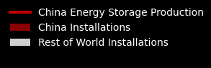
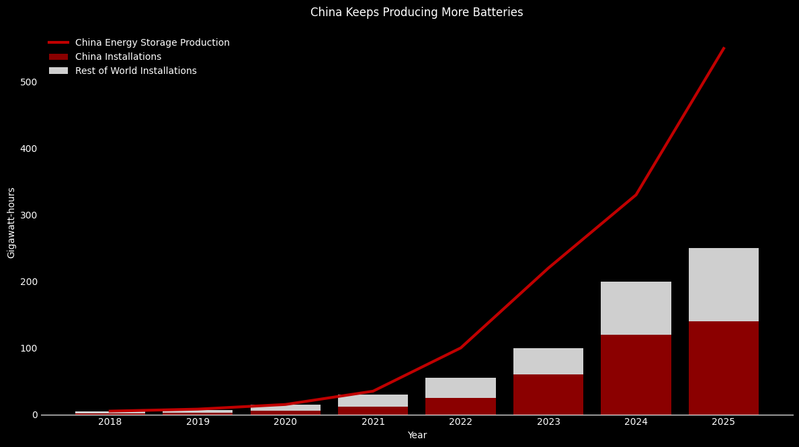
Electrification Depends on China
80% of battery production is geographically centered in China
Battery Production in China (Gigawatt-hours) as of YE 2025¹
Source: BloombergNEF, Ministry of Industry and Information Technology (MIT) of China, General Administration of Customs of China. Note: 2025 is estimated. Includes lithium-ion battery cells for stationary storage applications.

Slide 6
Ferrari’s Economics Confirm a Scarcity Model
High pricing power, expanding margins, and superior capital efficiency
Revenue +7% with flat shipments
Luxury-level profitability
ASP of €374k → €440k
 | EBIT ~30%
40% historical ROIC
 | 40-50% hybrid mix
Luxury-level profitability
No margin compression
As of December 2025.

Slide 7
Structural Tension: Brand vs BEV
Electrification alters the sources of differentiation in ultra-performance vehicles
Ferrari’s Historical Differentiation
BEV Standardization Risk
Engine sound
Throttle response & bespoke tuning
Soundless drivetrains
Controlled scarcity
Instant torque available to all
Emotional resonance
Regulatory-driven adoption
Mechanical engineering superiority
Commodi-tized metrics
Externally-sourced battery technology

Slide 8
Valuation Framework
DCF model based on 2015-2025 financials, projected through 2035
Temporary compression & elevated R&D with smaller returns during transition
Key Operating Assumptions
WACC Calculation
 | 2026 | 2030 | 2035
Revenue Growth | 13.37% | 11.35% | 3.00%
EBIT Margin | 24.27% | 23.32% | 26.00%
Tax Rate | 23.08% | 23.08% | 23.08%
Reinvestment Rate | 29.93% | 27.02% | 5.99%
ROIC | 44.67% | 42.01% | 50.12%
Market Value of Equity | € 54,009,288.30
Total Debt | € 2,884,220.00
W(E) | 94.9%
W(D) | 5.07%
Beta | 1.07¹
MRP | 5.5%
Risk Free Rate | 2.79%²
Cost of Equity | 8.67%
Tax Rate | 23.08%
After-Tax Cost of Debt | 1.10%
Terminal Growth Rate | 3.00%
WACC | 8.29%
Product mix stabilizes at 40% ICE / 40% Hybrid / 20% BEV
Source: CFRA RACE Report. As of March 2025.
Source: FRED.stlouisfed.org. As of February 20, 2026.

Slide 9
Intrinsic Value vs Market Price
The valuation implies a ~25-30% downside compared to the market
Enterprise Value
€41.6B
 | Equity Value
 | €40.2B
 | Intrinsic Value
 | €226.84/share
 | Market Price
 | ~€304/share¹
Sensitivity Analysis (EBIT vs Terminal Growth)
WACC / Terminal Growth | 2.50% | 3.00% | 3.50%
7.00% | €283.06 | €310.86 | €346.62
8.00% | €225.03 | €241.77 | €262.23
8.29% | €212.15 | €226.84 | €244.60
9.00% | €185.20 | €196.06 | €208.90
Even under relatively optimistic cases, the valuation requires sustained margin strength and minimal structural erosion.
As of February 23, 2026.

Slide 10
Final Recommendation: Short Ferrari
Will the transition to full electrification put Ferrari’s pricing power at risk?
Full BEV Transition
Commoditized Performance
Scarcity Driven Luxury
€ 226.84
Overvalued

